Slide 1
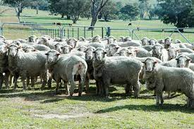
Underpinning Genomic selection with reference populations-outcomes of the MLA Resource Flock and what’s next
Julius van der Werf Daniel Brown, Sam Walkom
School of Environmental and Rural Science AGBU University of New England, Armidale NSW, Australia

Slide 2
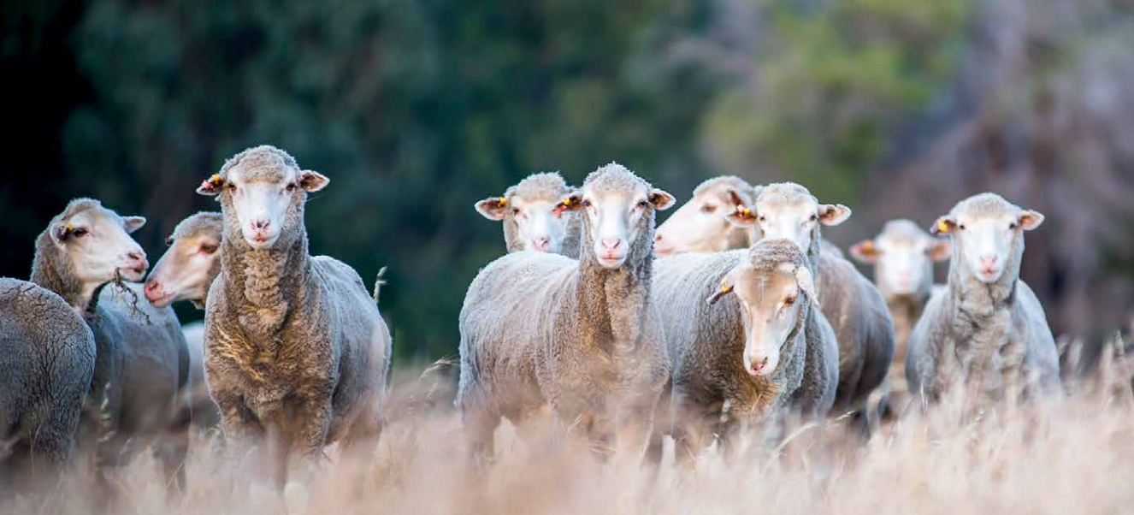
The role of the Resource Flock past, present and future
Genomic Selection
Breeding objectives / Emphasis on new traits

Slide 3
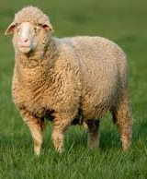
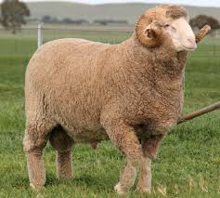
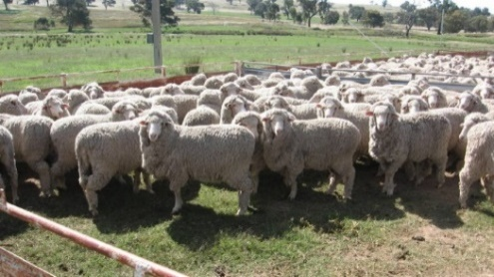
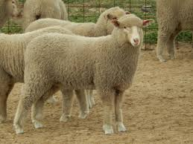
How to select the best animal ? before genomics
use some pedigree
Sire
¼
use some sibs
Dam
½
½
1
How does it perform ?

Slide 4
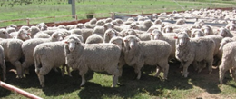


How to select the best animal ? with genomics
Resource Flock
Use some pedigree
Dam
Sire
½
½
¼
Use some sibs
1
How does it perform ?
Use a DNA test

Slide 5
The effect of genomic information means
We can now use information on many more ‘relatives’
Genomics gives potential to select now also for traits that were hard to improve before as not easily measured on breeding animals → Hard to Measure Traits
    Meat Eating Quality
    Reproductive performance
    Parasites
    Lifetime Wool
    Methane and Feed Efficiency

Slide 6
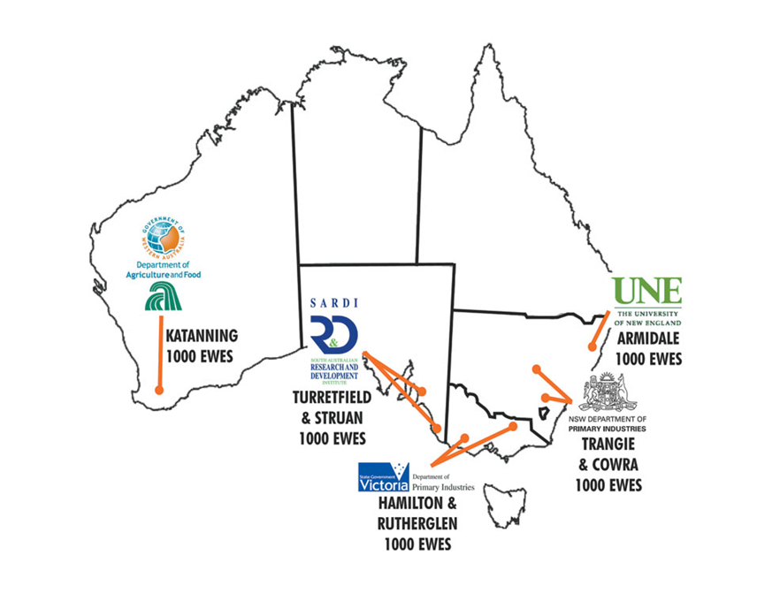
Resource Flocks in Australia
2007-2011 Sheep CRC (Information Nucleus)
  18, 000 lambs born and measured,
  10,000 for meat traits
  4,000 for repro and wool traits
2012- 2018 MLA Resource Flock
  12, 000 lambs measured for meat quality
2019- 2023 MLA Resource Flock v2
  10, 000 lambs measured for meat quality
  4000 lambs from commercial producers
  12,000 breeder’s ewes for reproduction
AWI: Merino Lifetime Productivity: 5000 ewes Lifetime Wool and Reproduction

Slide 7
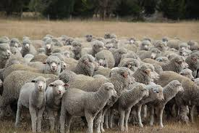
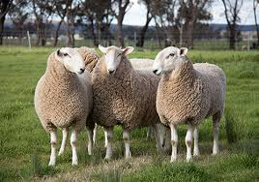
Resource Flock What type of sheep ?
  Pure Merinos 35%
  fine to medium
  Crosbreds 65%
    Maternal x Merino
    Terminal x Merino
    Terminal x 1st cross

Slide 8
Sires used in the resource flock
 |  | 2023 | 2022 | 2021 | 2022 | 2020 | 2019 | 2018 | 2017 | 2016 | 2015
sire breed | Doses per ram | Nr Rams | Nr Rams | Nr Rams | Nr Rams | Nr Rams | Nr Rams | Nr Rams | Nr Rams | Nr Rams | Nr Rams
White Suffolk/CT | 15 | 20 | 20 | 17 | 20 | 22 | 24 | 24 | 20 | 24 | 27
Poll Dorsett | 15 | 20 | 20 | 20 | 20 | 22 | 23 | 23 | 28 | 26 | 27
Dorpers/AW/shedders | 18 | 20 | 20 | 22 | 20 | 26 | 22 | 17 | 19 | 20 | 0
Southdown | 15 | 3 | 3 | 4 | 3 | 3 | 2 | 2 | 5 | 5 | 0
Hampshire | 15 | 2 | 3 | 3 | 3 | 0 | 2 | 2 | 0 | 0 | 0
CT | 15 | 0 | 0 | 3 | 0 | 3 | 2 | 8 | 3 | 0 | 0
Texel | 15 | 5 | 10 | 10 | 10 | 4 | 4 | 4 | 0 | 0 | 6
Suffolk | 15 | 10 | 5 | 8 | 5 | 9 | 2 | 2 | 8 | 6 | 6
Corridales | 15 | 6 | 6 | 3 | 6 | 3 | 2 | 2 | 3 | 0 | 0
Coopworth | 15 | 6 | 6 | 5 | 6 | 3 | 6 | 6 | 6 | 6 | 4
Mat Composites | 15 | 13 | 12 | 12 | 12 | 11 | 13 | 12 | 6 | 9 | 11
Border Leicester | 15 | 8 | 8 | 8 | 8 | 9 | 7 | 7 | 10 | 10 | 10
Mer SF | 18 | 5 | 5 | 5 | 5 |  |  | 8 | 8 | 8 | 15
Mer FM | 18 | 10 | 10 | 10 | 10 | 22 | 26 | 8 | 8 | 8 | 15
Mer DP | 18 | 15 | 15 | 10 | 15 |  |  | 10 | 10 | 10 | 15
SAMM |  | 3 | 3 | 0 | 3 | 5 | 0 | 0 | 0 | 0 | 0
Dohne | 18 | 4 | 4 | 10 | 4 | 12 | 15 | 15 | 15 | 15 | 15
Total ~ 150 sires/year, 2400 matings

Slide 9
Animals measured for IMF
YOB | INF/MRF |  | Other
2007 | 2,010
2008 | 1,935
2009 | 2,097
2010 | 2,186
2011 | 1,957 | 10,185
2012 | 2,126 |  | 164
2013 | 1,791 |  | 1,435
2014 | 1,817 |  | -
2015 | 1,730 |  | 201
2016 | 1,535 |  | -
2017 | 2,002 |  | 1,598
2018 | 1,528 | 12,529 | 1,577 | 4,975
2019 | 1,676 |  | 1,319
2020 | 2,117 |  | 456
2021 | 1,169 |  | 1,576
2022 | - | 4,962 | 357 | 3,708
Grand Total | 27,676 | - | 8,683 | - | 36,359

Slide 10
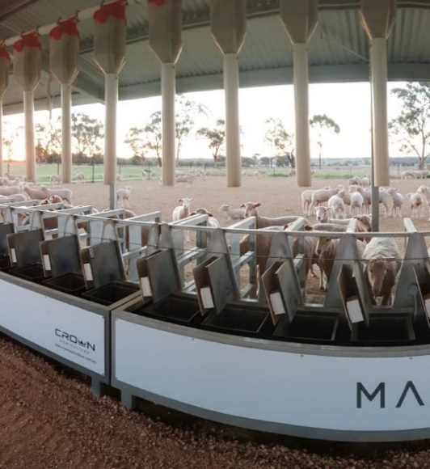
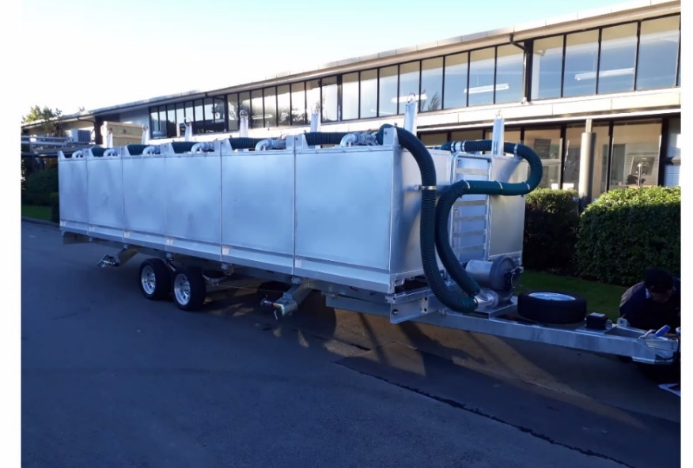
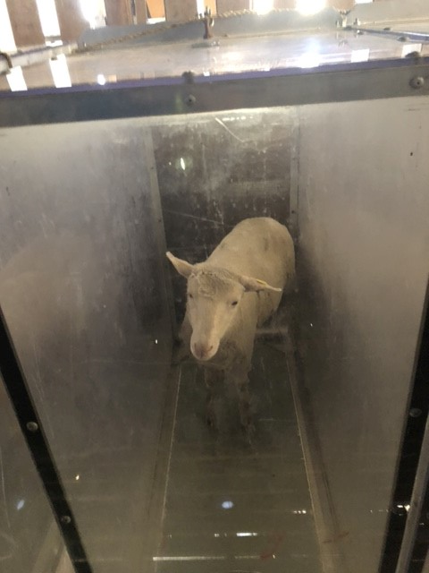

Portable Accumulation Chamber
Resource Flock What is NEW?
From 2022/2023 onwards:
Feed Intake
  Methane Feed Intake
Information from breeder flocks: Reproduction traits, wool, weights, genotypes

Slide 11
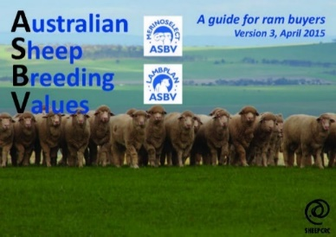
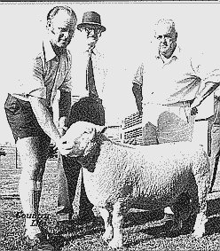
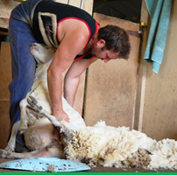
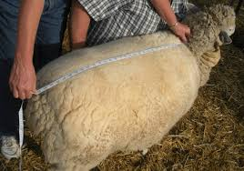
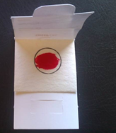
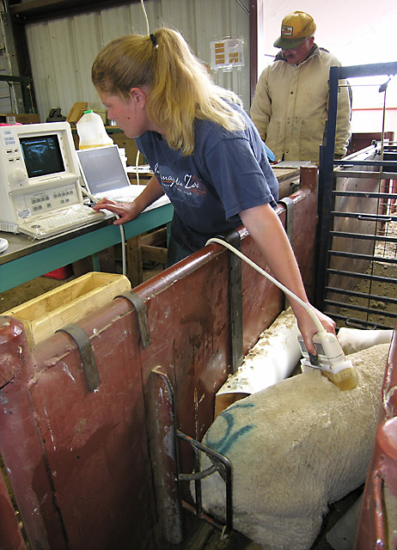

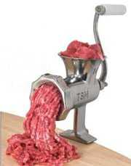

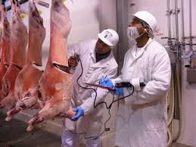
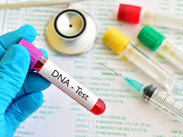
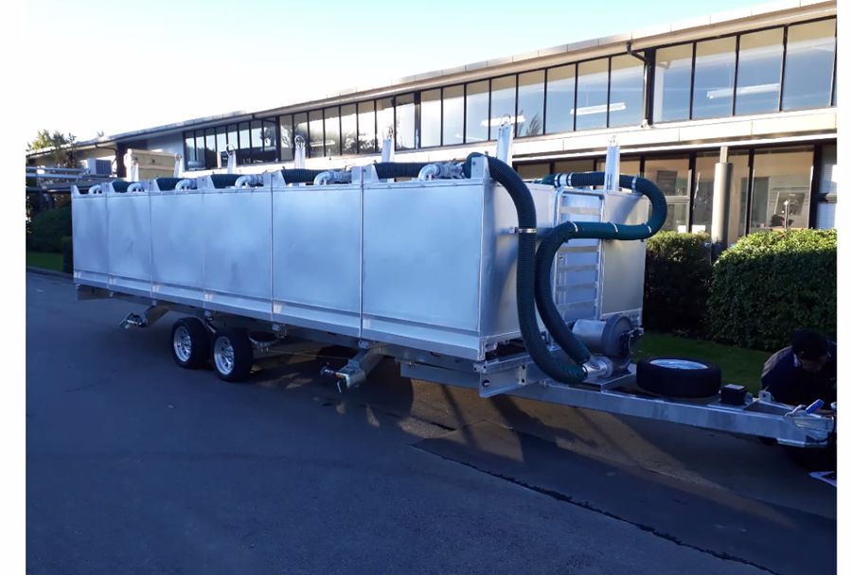

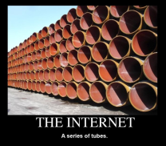
New traits can enter the existing ASBV Pipeline
Breeders collect measurements
…and a tissue sample
On farm traits
Breeding value to breeder
Genomic test
Reference pop traits
Data via the internet
Calculate breeding values
Calculate breeding values

Slide 12
Resource Flock What is Next?
maternal behaviour
lambing ease
condition score
parasites
fly strike
Resilience traits

Slide 13
Advantages of a genomic reference population
Predicting young breeding stock in the studs
Predicting young breeding stock in multipliers
Predicting commercial animals
  Replacement ewes
  Lambs in supply chains
  Crossbreds
  Across breed types

Slide 14
Further advantages of a reference population
  Progeny testing of sires
  Linking flocks
  Estimation of genetic parameters for new traits
  Overlay projects
Who benefits?

Slide 15
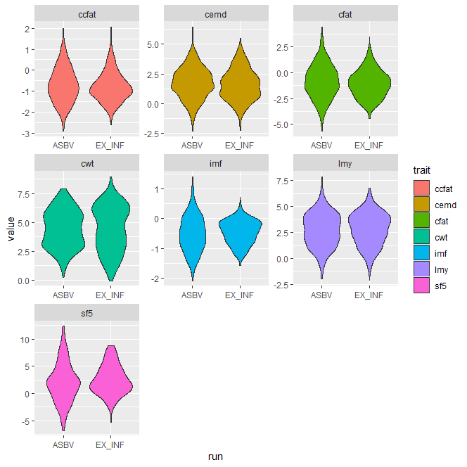
EBVs of sires with RF progeny, with and without RF data
840 sires
ASBV = all data
Ex-INF = RF data since 2017 removed

Slide 16
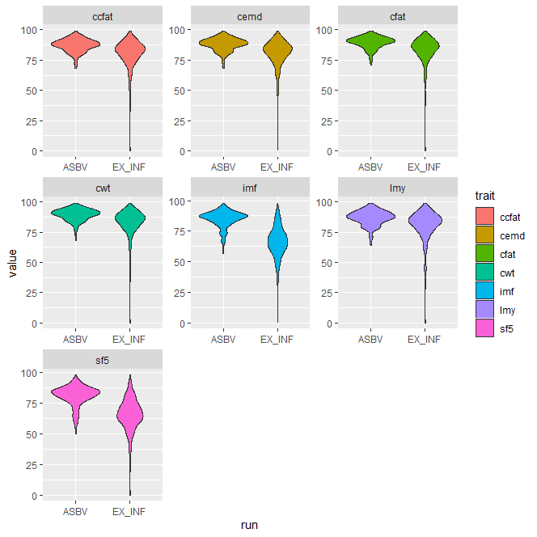
Accuracy increase of sires with RF progeny
840 sires
ASBV = all data
Ex-INF = RF data since 2017 removed

Slide 17
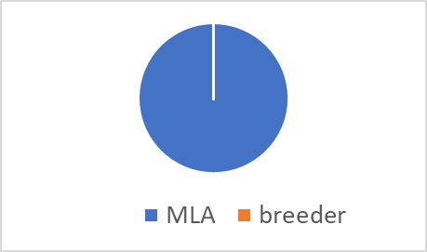
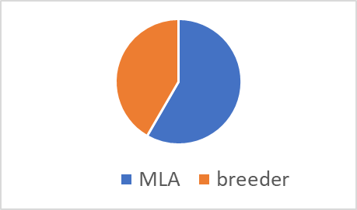
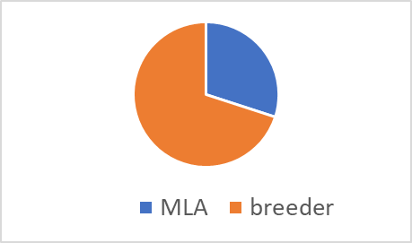
Current resource flock model
Investment:
150 sires
MLA
breeder
AI
Core Resource Flocks
2400 ewes
Kirby
Katanning
Temora
2000 lambs 13/sire
growth
methane/feed intake
eating quality
genotype
% budget
83%
other sires
Satellite Flocks
Commercial ewes
Various commercial
1000 lambs 5-20/sire
eating quality
genotype
12%
2500 ewes
Repro data
genotype
5 %
Breeder Flocks
2500 breeder ewes

Slide 18
Possible next resource flock model
150 sires
1500 lambs
growth
methane/feed intake
eating quality
genotype
AI
Core Resource Flocks
3400 ewes
Kirby
Katanning
Temora
1500 ewe progeny
Reproduction x3
Maternal x3
methane/feed intake
genotype
NM
other sires
lambs
eating quality
genotype
Satellite Flocks
Commercial ewes
Various commercial
AMSEA?
Ewe progeny
Reproduction x3
Maternal x3
genotype
Breeder Flocks
2500 breeder ewes
2500 ewes
Repro data
genotype

Slide 19
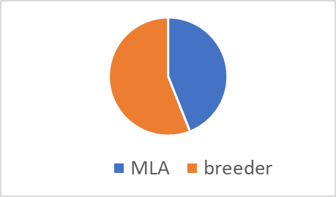
Possible next resource flock model note: strawman model only!
Co-investment model
~Cost per ram
150 sires
1500 lambs
growth
methane/feed intake
eating quality
genotype
AI
Core Resource Flocks
3400 ewes
Kirby
Katanning
Temora
10 prog
$2,700
1500 ewe progeny
Reproduction x3
Maternal x3
methane/feed intake
genotype
10+
15 prog
NM
$6,500
other sires
lambs
eating quality
genotype
Satellite Flocks
Commercial ewes
Various commercial
AMSEA?
10 prog
$1,800
Ewe progeny
Reproduction x3
Maternal x3
genotype
Breeder Flocks
2500 breeder ewes
2500 ewes
Repro data
genotype

Slide 20
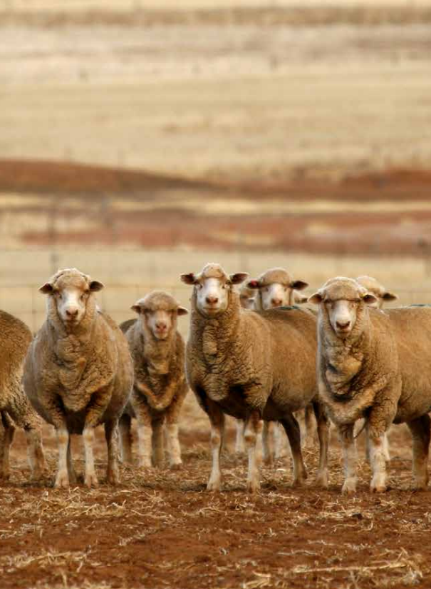
Conclusion
Resource Flock key for genomic prediction of novel traits
Large industry benefit
Benefit for breeders
Future models require co-investment
Need to explore feasible models

